Slide 1

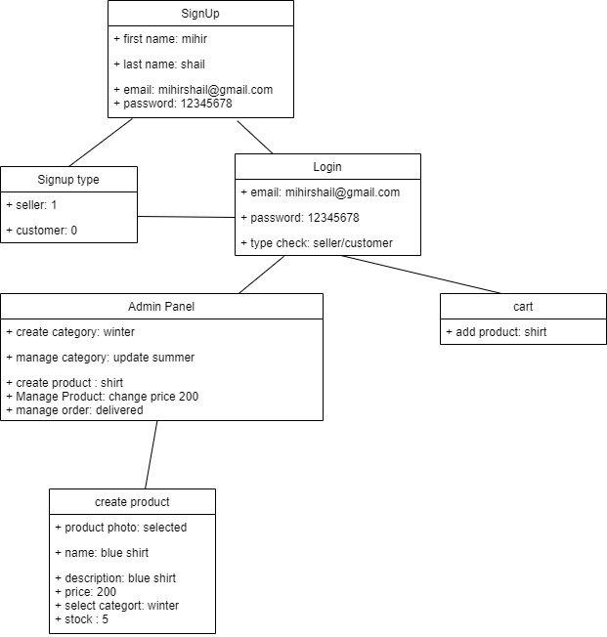
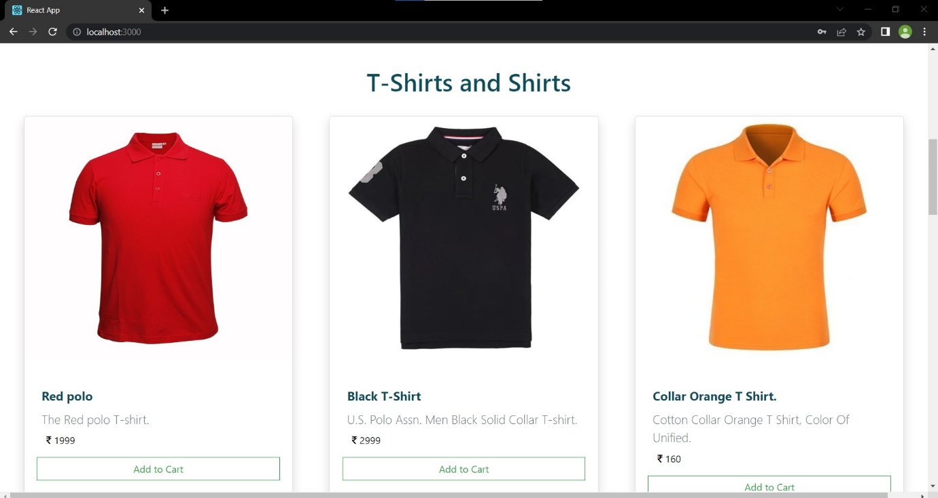
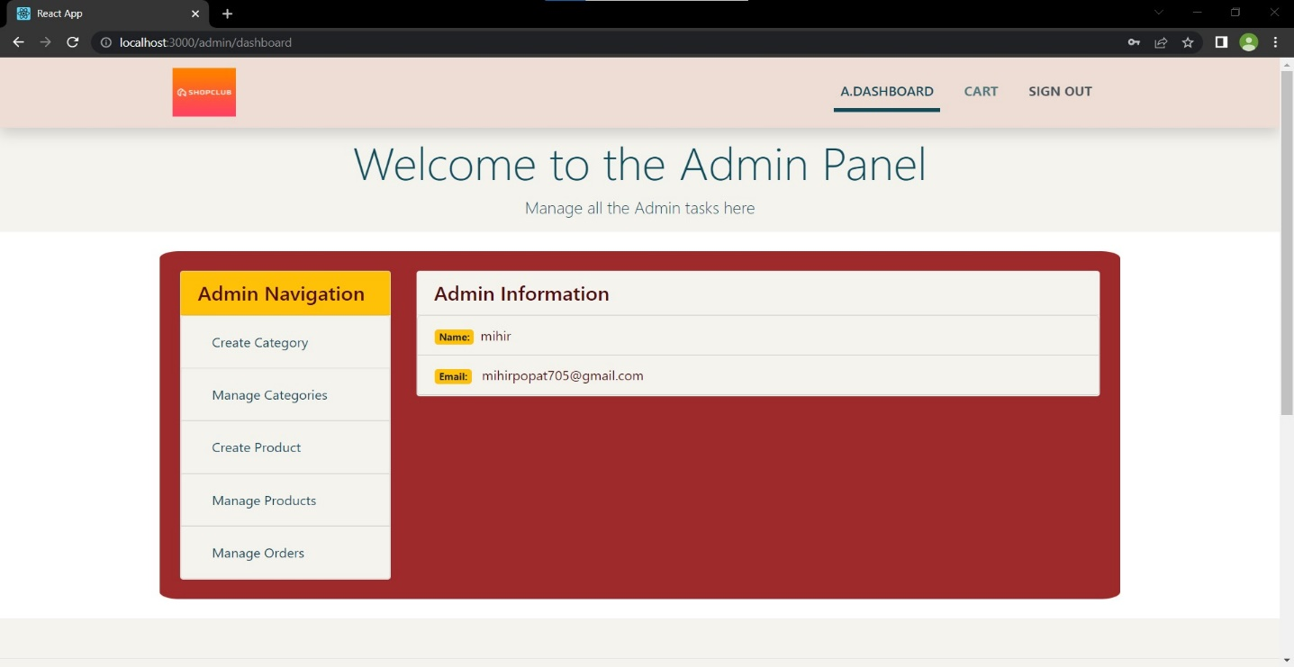
PC-649: M.Sc (IT) Summer Internship
E-Commerce Website
Mihir Popat(202112073)
Shail Parekh (202112128)
Mentor Name : Prof. Satyendrasingh Chouhan Sir
About the Project
The aim of this project is to provide individual small businesses a separate platform so that it gives their business presence on the internet and gives advantage to reach more customers and helps to build their own brand on the internet. We have Provided different dashboard for customer and seller. With the help of this system seller can sell products by creating product category, Manage Categories, create product, manage products, manage orders with the help of admin panel. we have also provide Contact us form so that customer can able to give feedback.
Solution
It is E-Commerce Website for small business to help them to sell products online by providing separate individual platform. It includes all of the features that seller need to while sell the products online like create product category, manage categories, create product, manage product , manage orders, customer feedback form.
Tools and Technology :
HTML,CSS, JavaScript,MongoDB,
NodeJs, ReactJS.
Software Design
Object Diagram
Some Snaps of Project
User Home Page
Admin Panel Home Page

